Slide 1


Rotary Club of Seattle
New Member Orientation
Title Page Option

Slide 2
So Far….
You should have received your welcome email from Club Director Mary Goldie
You have been (or will be!) paired with a member mentor soon!

Slide 3
Orientation highlights
History of Rotary Locally, Internationally
Blue Badge Checklist
Club Culture and Expectations

Slide 4
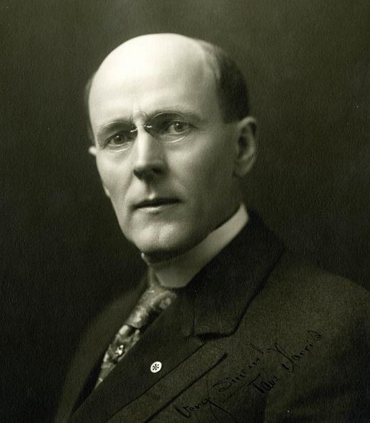
Rotary International
Rotary was created in 1905 by Paul Harris. Harris was a Chicago businessman that created the first club as a way for businessmen to network across professions, developing life-long friendships along the way. It was called “Rotary” because meetings would be hosted at member’s workplaces, rotating among venues!
Notes:
Picture of Rotary Club of Seattle picnic sack race in 1917

Slide 5
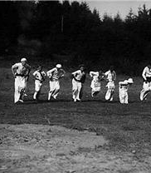
Rotary Club of Seattle
Established in 1909 as the fourth Rotary club in the world!
Notes:
Picture of Rotary Club of Seattle picnic sack race in 1917

Slide 6

Rotary Ecosystem: More than one Club!
Rotary International (46,000 clubs across the world)
  Club are organized into Rotary ZONES by region. We are in the PNW PETS zone, which encompasses PNW states and parts of Canada
    Zones are further divided into Rotary DISTRICTS. We are in Rotary District 5030, which includes Seattle and surrounding area clubs. There are many district events and opportunities our members can take advantage of
      Your Rotary Club of Seattle!

Slide 7
10 Steps:
  Step # 1: Submit initiation fee
  Step #2: Set up monthly club dues autopay
  Step #3: Schedule new member introduction
  Step #4: Rotary Club of Seattle (RCOS) Orientation and download ClubRunner app
  Step #5: Seattle Rotary Service Foundation (SRSF) orientation
  Step #6: Greeting at club lunches
  Step #7: Donate to The Rotary Foundation (TRF)
  Step #8: Donate to Seattle Rotary Service Foundation (SRSF)
  Step #9: Join a committee!
  Step #10: Notify Club Director & Mentor Committee Co-Chairs of your completion!
Blue Badge Checklist
New member guidelines

Slide 8
STEP #1: Submit Initiation Fee
You will receive an email from QuickBooks with the first invoice to pay the initiation fee. Please ensure you have or create an account in QuickBooks.
Pay the one-time $400 initiation fee to activate your membership!

Slide 9
STEP #2: Set up dues autopay
The next invoice you get from QuickBooks will be to start your monthly dues processing.
Please set up autopay with the instructions provided.

Slide 10
STEP #3: Success! Now time to schedule your new member introduction!
YOU WILL BE FORMALLY INTRODUCED AS THE NEWEST ROTARIAN IN THE WORLD, by fellow club members during A club lunch meeting
Once your initiation fee is processed and your monthly dues are setup, contact ANI BLACK to let her know you are ready to be introduced!
A club member will be paired with you, and your introduction will be scheduled
Introductions are typically biographical with information about your background, education, professional career, and other personal achievements or notable things about you. Hobbies and fun interests are encouraged!

Slide 11
STEP #4: Seattle 4 orientation (this presentation) and DOWNLOADING ClubRunner, Our membership APP
AREAS OF FOCUS:
Search membership and find contact information
Learn to register for club lunches and events
Desktop and app versions available
Access historic data about club participation, RI donations
Our club website (seattlerotary.org) is the login page for the desktop version. Please click on “Member Area” to access.

Slide 12
STEP #5: Schedule your Seattle Rotary Service Foundation (SRSF) Orientation
SRSF is OUR 501c3 that all RCOS members SUPPORT!
Contact SARAH WEAVER to schedule your SRSF Orientation
Learn about:
  SRSF Mission
  SRSF History
  SRSF Operations
      Grants
      Campaign
      Service
      Local and International Impact

Slide 13
STEP #6: Greet at 4 lunch meetings
In-person lunch meetings are on the 1st and 3rd Wednesday monthly
Reach out to Club Director MARY GOLDIE to register your time slots
Great way to get to know many club members, fast!

Slide 14
STEP #7: Donate to The Seattle Rotary Service Foundation (SRSF)
The Seattle Rotary Service Foundation is the Internal charitable arm of the Rotary club of Seattle that transforms donations into funding for local and international service projects
Annual donation is >$500 per year (suggested)
This link to donate directs you to a live form for credit card and ACH donations.
This link to donate directs you to indicate other ways you’d like to pledge to give (Donor Advised Fund, Stock, etc.)
Please try to make your donation between October 1-January 31 each year to align with the campaign promotion window.

Slide 15
STEP #8: Donate to The Rotary Foundation (TRF): CLUB ID #130
TRF is the 501c3 for Rotary international that transforms our local donations into global impact
Annual TRF donation is a minimum of $100 per year (excpected)
Use This link to donate via My Rotary, Rotary International’s digital platform.
Log in & create an account in My Rotary before donating so your donation is credited to our club.
The official TRF campaign is every year from October 1 - January 31.

Slide 16
STEP #9: Join A Committee!
CHOOSE YOUR ROLE IN YOUR club and community!
Local Service Committee (LSC)
International Service Committee (ISC)
Programs
Music
Inspiration
Seattle Rotary Mariners
Membership
Rotary Cares
Newsletter Reporting
New Member Introduction

Slide 17
STEP #10: get your blue badge!
email our club director and mentor committee co-chairs!
Let them know you have completed 1-9!
Mary Goldie, Club Director
mary@seattlerotary.org
Ani Black, Mentor Committee Co-Chair
abrewsterb@icloud.com
Stephen Morse, Mentor Committee Co-Chair
stmorse@rwbaird.com

Slide 18
JOIN club events
There are ADDITIONAL OPPORTUNITIES to ENGAGE!
Committee meetings
Board meetings
Service projects
Fellowship events
Zoom only lunch meetings (4th Wednesday of most months)
Holiday party in December
President’s party in June
Rotary District 5030 Events

Slide 19

Club Culture & Expectations
Title Page Option

Slide 20
It is an expectation that you attend lunches and events monthly
  “Regular” means different things to different people but aim to attend at least one club event a month!
  Check the newsletter and events page on the website weekly.
Club members may reach out via phone call, text, or email regarding getting involved
  Be responsive and timely when it comes to club communications!
BONUS Rotary offerings locally:
  RISE Leadership Training Program
  District Rotary Training for Leadership Roles
  Travel to conferences
  Visit another club
Expectations of new members

Slide 21
Appropriate networking at Rotary:
  Exchanging business cards
  Offering your place of work or home as a venue for a club social or service event
  Donating to SRSF through your company or becoming a meeting sponsor
  Asking the Club Director or others for introductions to members working in your professional field
  Inviting others for coffee
  Connecting a nonprofit you champion to SRSF grant and service opportunities
Inappropriate networking at Rotary:
  Adding member lists to your promotional email campaigns
  Requesting or expecting that members attend or financially support external fundraisers outside of current club community partnerships
    Apologies, but we don’t announce these in the newsletter!
networking in rotary

Slide 22

QUESTIONS?
Contact your MENTORS!

